Slide 1
Asynchronous Web Apps with Play 2.0
Oscar Renalias

Slide 2





About me
Oscar Renalias
oscarrenalias
github.com/oscarrenalias
oscar.renalias@accenture.com
oscar@renalias.net

Slide 3
What we’ll do today
Take a look at Play’s asynchronous capabilities
Real world usage scenarios

Slide 4

?
Stateless
Asynchronous
Reactive
RESTful
Notes:
Stateless - TODO
Asynchronous - TODO
Reactive - TODO
RESTful - TODO

Slide 5

Scalability
Why Async??
Performance
Responsiveness
Notes:
Why do we want to do this?
Scalability – when something is blocked waiting for IO or for an operation that will take long, we’re restricting the scalability of our application since an entire thread is dedicated to wait for whatever is blocking. Once we’ve consumed our thread pool and they’re all waiting for something to happen, no more requests can’t be served and our clients start to pile up. Not good.
Performance
Responsiveness
And because users expect all web applications to behave like Facebook, Gmail and Twitter – highly dynamic, user-friendly and responsive. Why should our applications be any different?

Slide 6
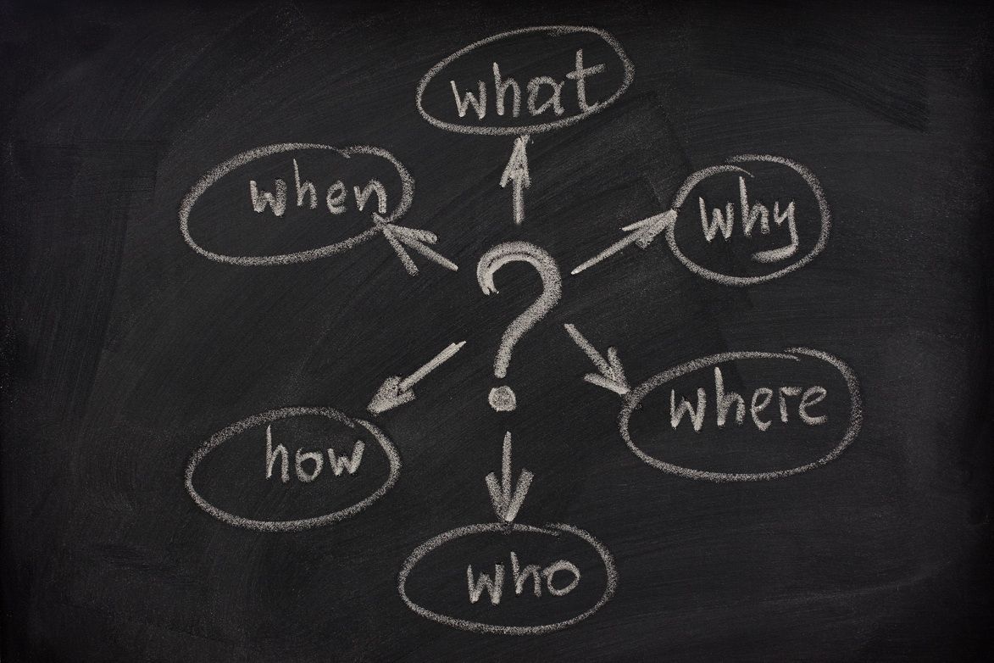
Haven’t we done this before?
Notes:
But – haven’t we tried to do this before, with somewhat mixed results?
YES, we have

Slide 7
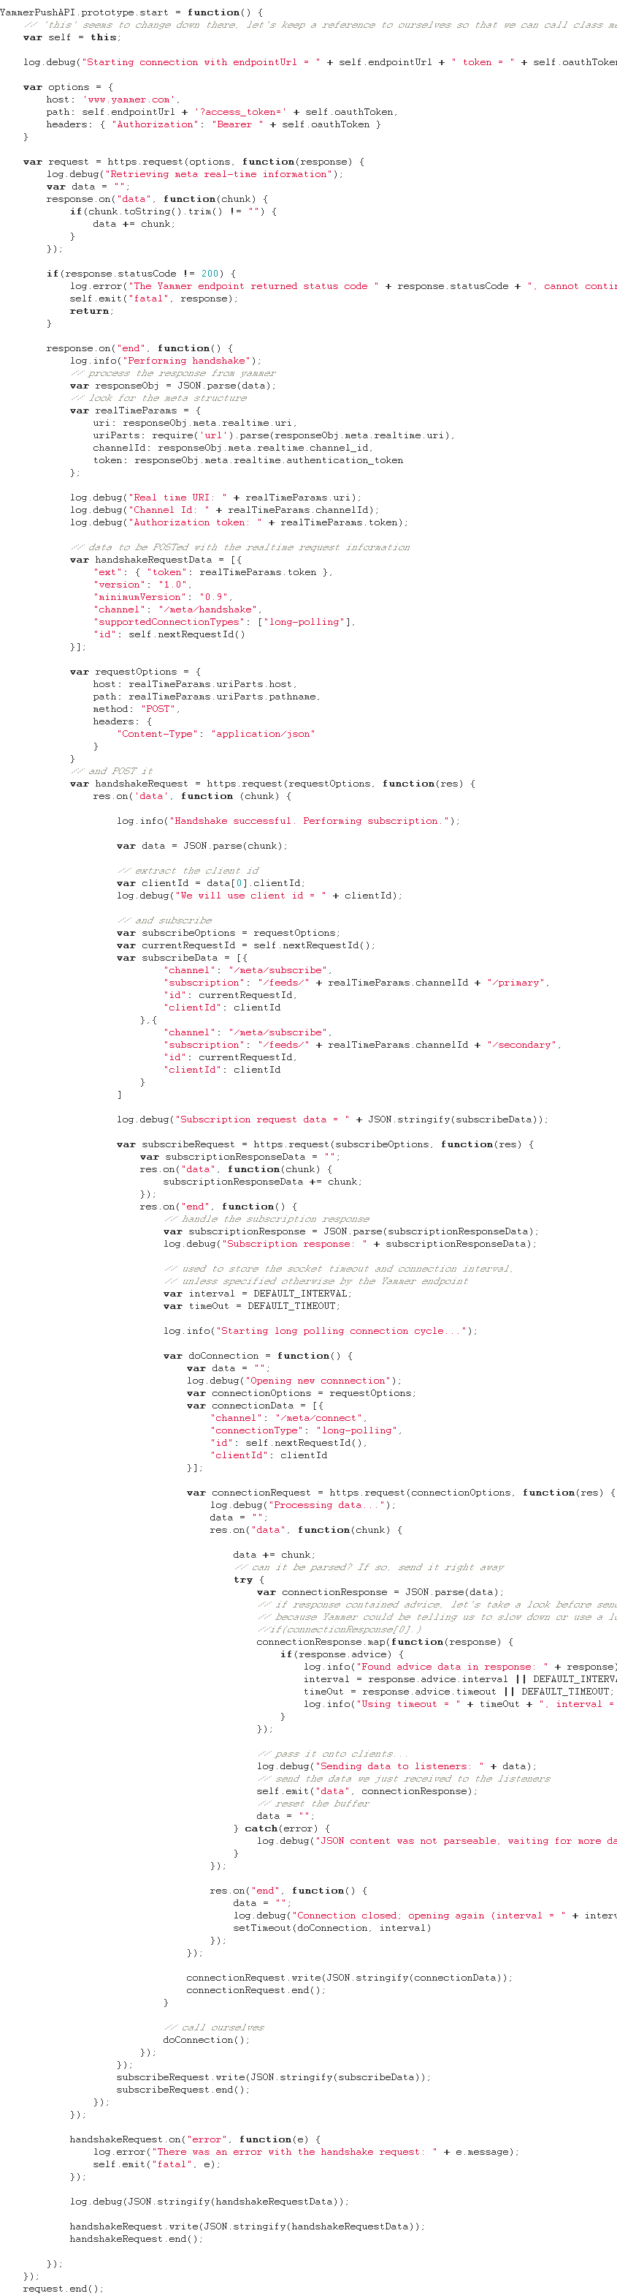

YES
we
have,
with
callbacks
Callback handler!
Callback handler!
Callback handler!
Callback handler!
Notes:
One of the best current examples of a framework or platform that provides asynchronous capabilities using callbacks is NodeJs. While it is a very powerful and flexible platform (together with frameworks such as Express), callback-hell is only a couple of callbacks away (e.g. web request that calls a database that calls a web service and returns the result). It is also based on a single thread and an event loop, so it requires that our business logic runs fast (or blocks a lot)
There are ways around it (return continuations/functions instead of nesting them within the same block) but that’s not always used.

Slide 8
Other attempts
App-server specific, e.g. Jetty continuations
NIO/Netty
Servlet 3.0
Notes:
Please note that the asynchronous capabilites are mixed up here: some of these provide asynchronous and non-blocking request handling (Jetty continuations) while others provide non-blocking IO (NIO)
The problem with most of these is that they are either too low-level (NIO and derivatives such as Netty or Servlet 3.0 with explicit async context handling) or are way too verbose and explicit (Jetty continuations)
That does not mean that they are not candidates, depending on the scenario sand requirements. In fact the Play Framework 2.0 itself is built on top of Netty, and its asynchronous abstractions are simply built on top of Netty’s and Akka’s functionalities.

Slide 9
Play’s asynchronous capabilities
Asynchronous requests
Non-blocking reactive IO
Notes:
The Play Framework 2.0 brings both to the table: non-blocking IO using reactive patterns and non-blocking request and response processing.
Let’s take a look at asynchronous request handling first.

Slide 10
Asynchronous Request Handling in Play
“Don’t call us, we’ll call you”

Slide 11
Asynchronous requests in Play
Futures
Promises
Asynchronous results

Slide 12
Planning for the Future
A Future is a read-only placeholder for a value that may be available at a later stage
Notes:
A Promise is a result generated by a future, that has not been “extracted” yet.
In Play, Futures and promises are used in very indistinguishable ways most of the times even if they refer to similar concepts.
Optionally, we can block on Futures and Promise while we wait for them to finish.

Slide 13
Making Promises
val promiseOfPIValue: Promise[Double] =
computePIAsynchronously()
val promiseOfResult: Promise[Result] =
promiseOfPIValue.map { pi =>
Ok("PI value computed: " + pi)
}
Promise[Something] → Promise[Result] → Browser
Notes:
The example above is shamelessly ripped from the Play official documentation ☺
Essentially, first we have an operation that generates a Promise of some type, and later we turn that Promise[Something] into a Promise[Result], which is what we can give to Play as an asynchronous result.

Slide 14
This is the Future
val f = Akka.future {
longOperation()
}
val f2 = f.map(s=>handleContents(s))
f2.value.fold(
ex=> handleError(ex),
value=> handleOk(value)
)
Notes:
Akka.future is by far the easiest way to generate Promise[Something] in Play.
Technically, we could pretty much handle asynchronous operations like this except that at the end of the processing we would need to block the thread handling our action by requesting the value from the Promise to be unwrapped.
Can we do better?

Slide 15
Making our actions asynchronous with asynchronous responses
object MyController extends Controller {
def simpleAsyncAction = Action {
val p = Akka.future { Ok("Done") }
new AsyncResult(p)
}
}
Notes:
Replace Ok(“done”) with your own long-running business logic that returns a Result

Slide 16
AsyncResult gets very tedious very soon. Can we do better?
def orders = Action {
Async {
Akka.future {
SalesOrder.findAll
} orTimeout(Ok(Json.toJson(JsonError("Timeout"))), 5, SECONDS) map { orders =>
orders.fold(
orders => Ok(Json.toJson(orders)),
error => Ok(Json.toJson(JsonError("Error")))
)
}
}
}
Notes:
Async is a wrapper for what we’ve seen before and is the preferred way, and it basically takes a Promise[Result] and takes care of waiting for the result to be available, *asynchronously* and return it to the client. In other words, it’s a helper method that builds an AsyncResult from a Promise[Result] automatically for us.
If the content in the red markers is replaced with Json content instead of plain text responses, we’ve got ourselves a JSON API

Slide 17
Asynchronous responses in the real world
def WithFuture[T](seconds:Int)(f: => T)(implicit jsonHelper:Writes[T]) = {
Async {
Akka.future {
f
} orTimeout(Ok(Json.toJson(JsonError(”..."))), seconds, SECONDS) map { result =>
result.fold(
data => Ok(Json.toJson(data)),
error => Ok(Json.toJson(JsonError("Error")))
)
}
}
}
def prettyOrders = Action {
WithFuture(1) {
SalesOrder.findAll
}
}

Slide 18

Demo: Promises, Futures and asynchronous responses

Slide 19
Asynchronous web services
Async {
WS.url("http://.../").get().map { resp =>
Ok(someJsonContent(response))
}
}
Notes:
What if we could do web service calls to other RESTful endpoints asynchronously, and leave the framework the responses whenever they’re ready?
Meet WS.url.
WS.url.get()/post()/etc return a Promise – result: we don’t have to do anything special; let the request finish, do something with its contents, return the promise and let the framework handle the response to the client whenever it’s ready. EPIC WIN.

Slide 20
Demo: Asynchronous web services

Slide 21

IO WHAT??

Slide 22
Reactive IO
What if we could implement our IO logic in a way that output is only generated in reaction to input, as opposed to block waiting for input?

Slide 23
Reactive IO
Enumerator = producer
Iteratee = consumer

Slide 24
Enumerators: the theory
Trait Enumerator[E] {
def apply[A](i: Iteratee[E, A]): Promise[Iteratee[E, A]]
}
Iteratee → Enumerator → another Iteratee

Slide 25
Enumerators produce data
val stringEnumerator = Enumerator("one", "two", "three", "four")
val updateGenerator = Enumerator.fromCallback { () => Promise.timeout(Some(Update.random), 5000 milliseconds)
}
Notes:
From a more pragmatic perspective, enumerators simply produce data. While it is good to know the functional foundations behind Play, we’ll rarely ever have to create our own Enumerators from scratch.
Some of the most common ways to create enumerators are:
Enumerators from a list of strings
Enumerator.fromCallback – return something from a callback, such as Promise.timeout for returning things on a regular schedule, or from really anything that can produce callbacks

Slide 26
Enumeratees
Enumerator
Enumeratee
Enumeratee
Iteratee
Notes:
Eumeratees convert the data generated by an Enumerator, and are composable and chainable because an Enumeratee produces a new enumerator.
Some of the common enumeratees as Enumeratee.map, Enumeratee.
The type signature for an Enumeratee is

Slide 27
Useful Enumeratees
Enumeratee.map
Enumeratee.filter
Enumeratee.drop Enumeratee.take
Notes:
Enumeratee.map processes input data from another enumerator or enumeratee and transforms items with the given function
Enumeratee.filter filters out certain types of input from an enumerator
Enumeratee.

Slide 28
Behind the scenes with Iteratees
def fold[B]( done: (A, Input[E]) => Promise[B],
cont: (Input[E] => Iteratee[E,A]) => Promise[B],
error: (String, Input[E]) => Promise[B]
): Promise[B]
Done: there is no more input
Cont: more input incoming
Error: there was an error with the input
Notes:
Essentially, Iteratees act as a sink for input that is generated by an Enumerator and possibly mapped with an Enumeratee.
Working with iteratees consists of repeatedly calling the fold() method with the given input in order to check what the next status is.
But all these operations are fairly low-level, so there are abstractions available that simplify that work in the Iteratee object.

Slide 29
Simplified Iteratees
Iteratee.foreach
Iteratee.fold
Iteratee.consume

Slide 30
Reactive IO and HTTP responses
Ok.feed(iteratee)
Ok.stream(iteratee)
Ok.stream(enumerator)
Notes:
Using Ok.feed and Ok.stream we can use our Iteratees and our Enumerators/Enumeratees to return non-blocking responses to clients. Their non-blocking nature ensures that no processing time is wasted on them while there is no input, while the framework will ensure that data is sent to clients as soon as it becomes available.
Ok.stream will send the response as an HTTP chunked response for us

Slide 31
Reactive IO in the real world
Streaming APIs
File streaming
Server-generated events
Reactive data

Slide 32
Streaming Files
Enumerator.fromFile
Or
Ok.sendFile(new File(…))
Notes:
Enumerator.fromFile gives us a totally straightforward mechanism for streaming data from a file as an Enumerator, which we can naturally map with Enumeratee and process with an Iteratee or just feed it into Ok.stream/Ok.feed.
More generically, Enumerator.fromStream is also available and that will allow us to plug in any InputStream of any kind as an enumerator.

Slide 33
Streaming APIs
Data source (Enumerator) → Enumeratee → Client
Notes:
The easiest way to implement scalable, asynchronous non-blocking streaming APIs is to use Ok.stream as it returns chunked responses and will suspend the thread if no data is available to be pushed.
Our enumerator can be then reading data from a database, waiting for external events (like a PushEnumerator) or reacting to a callback event like Enumerator.fromCallback.
Naturally the data produced by the enumerator can be transformed using Enumeratees along the way.

Slide 34
WebSockets
def websocketTime = WebSocket.async[String] { request =>
Akka.future {
val timeEnumerator = Enumerator.fromCallback { () =>
Promise.timeout(Some((new Date).toString()), 5000 milliseconds)
}
val in = Iteratee.foreach[String] { message =>
println(message)
}
(in, timeEnumerator)
}
}
Notes:
WebSockets in Play are built on top of Enumerators and Iteratees. The main thing to keep in mind with websockets is that we must always return a pair of an iteratee and an enumerator; if using WebSocket.async we’ll wrap them in a future and if using WebSocket.using, we’ll return them unwrapped.
This means that when using websockets we have to be very much explicit about how we expect the websocket to produce and consume the data; here the “produce” step

Slide 35
Demo: Reactive IO
Notes:
Now we’re going to see a brief demo of all the concepts we’ve seen so far:
An HTTP publish-subscribe type of API built using an imperative enumerator and an Actor to process events and distribute them to clients. Since one enumerator can only feed one iteratee (it’s a 1:1 relationship as opposed to 1:n), we need this actor to react to a message event and push it into all the PushEnumerators that it will keep in an internal list. Not a single blocking code in sight.
A model class that returns an Enumerator rather than a list of elements. The biggest advantage here is that for large amounts of data, we are not loading all of them into memory and then returning it to the calling class but instead data is delivered to the client as it is loaded from the database.
WebSockets - TODO

Slide 36
A glimpse of the future: Reactive Mongo
val cursor = collection.find(query)
val futureListOfArticles :Future[List[Article]] = cursor.toList
futureListOfArticles.onSuccess { articles =>
for(article <- articles)
println("found article: " + article)
}
Notes:
http://reactivemongo.org/
ReactiveMongo is a library currently under development that formalizes the usage of Play’s reactive IO for accessing a MongoDb data storage using the non-blocking patterns that we have just seen such as enumerators and Futures.

Slide 37
All work and no makes Jack a dull boy (but there’s still hope)
Grails 2.0 + Servlet 3.0
def index() {
def ctx = startAsync()
ctx.start {
new Book(title:"The Stand").save()
render template:"books", model:[books:Book.list()]
ctx.complete()
}
}
Notes:
Can’t work with Play? No problem, other frameworks are catching up and eventually the development of asynchronous applications will be commonplace.
One of the biggest enablers of asynchronous applications is the servlet 3.0 spec, which allows applications to mark certain requests as suspended and allow the app server to handle those in the background.
The example above is based on Grails 2.0 + a Servlet 3.0 server (such as Tomcat 7.0), just to see how it works. As you may have already noticed, it shows a bit too much of the low-level interface by forcing controller classes to handle asynchronous contexts… In my opinion Play’s API is more elegant but Groovy lends itself very nicely to internal DSLs so it’s likely that the Grails guys will work on some higher-level abstractions to make development easier.
Note: the example is taken from the Grails 2.0 release notes.

Slide 38
All work and no makes Jack a dull boy (but there’s still hope)
Vert.x
public class ServerExample extends Verticle {
public void start() {
vertx.createHttpServer().requestHandler(new Handler<HttpServerRequest>() {
public void handle(HttpServerRequest req) {
System.out.println("Got request: " + req.uri);
System.out.println("Headers are: ");
for (String key : req.headers().keySet()) {
System.out.println(key + ":" + req.headers().get(key));
}
req.response.headers().put("Content-Type", "text/html; charset=UTF-8");
req.response.end("<html><body><h1>Hello from vert.x!</h1></body></html>");
}
}).listen(8080);
}
}
Notes:
Vert.x defines itself as “Effortless asynchronous application development for the modern web and enterprise”. It’s not a coincidence that in their efforts to implement a high-performance asynchronous web framework, the Vert.x development team also kept away from JEE ☺
However as opposed to Play, Vert.x’s architecture is based on the callback-style mechanism. While I have no direct experience developing large-scale applications or applications with complex logic on Vert.x, it remains to be seen how efficient this approach is in those cases.

Slide 39
Github repo or it didn’t happen
https://github.com/oscarrenalias/wjax-2012-play-async-apps
Notes:
The link above contains all the example code showed today as well as other stuff that we did not have time to cover.

Slide 40
Notes:
Shameless plug ☺
At Accenture we have also been training ourselves with Play 2.0 (both Java and Scala) and we are currently delivering an interesting project on Play Java and preparing to deliver an even more interesting one with Play Scala to implement a highly-scalable API so we are ready to help you and clients in general with these innovative technologies and frameworks (even if innovation and say, Scala, are not the first things that come to your minds when you think of Accenture)

Slide 41
?

Slide 42
Thank you

